Slide 1



Designing a semi-automated approach to find potential evidence of corporate greenwashing
EPA Master Thesis Defense
Ludovica Bindi
Notes:
This thesis is about designing a semi-automated approach that can detect evidence of greenwashing

Slide 2

Agenda
The greenwashing phenomenon
My created solution
Results
Conclusions

Slide 3
The greenwashing phenomenon
A brief introduction and research questions

Slide 4
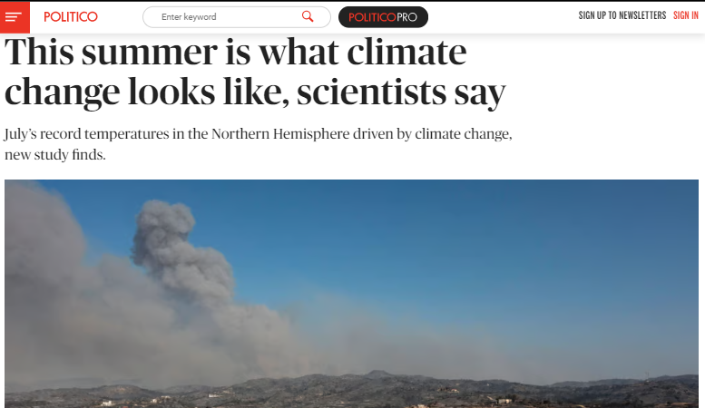
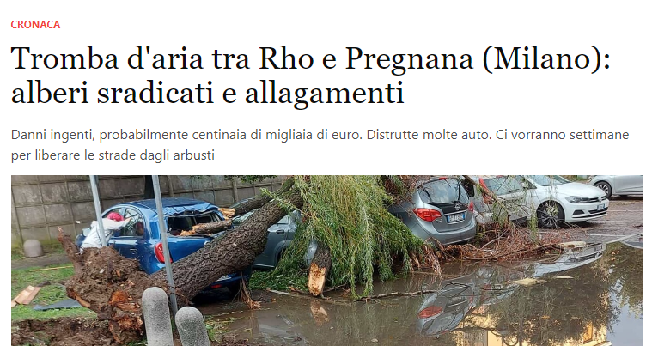

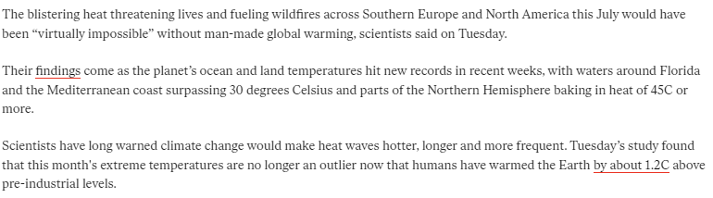
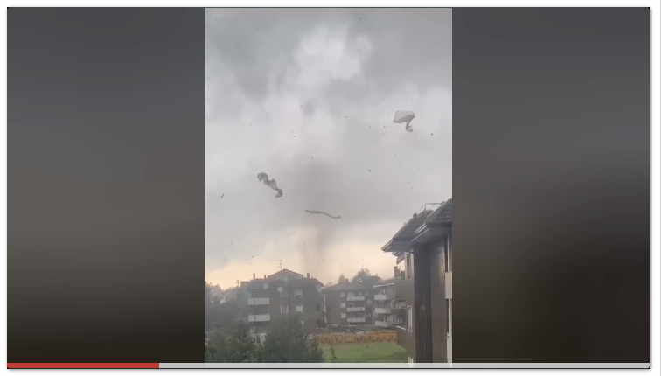
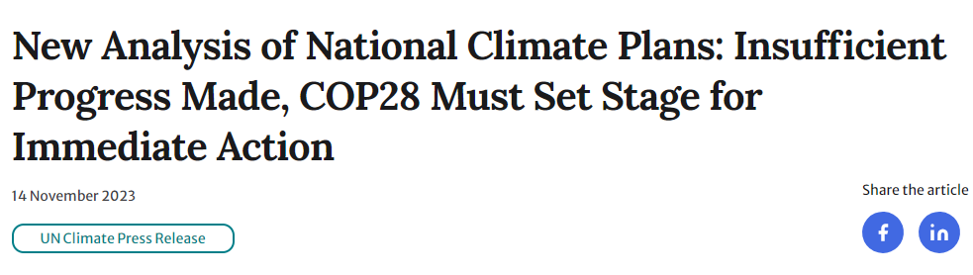
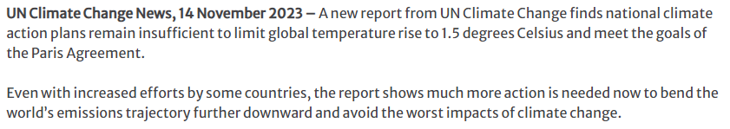

Notes:
The effects of climate change were visible in the last year
Examples of what is happening now
The hottest summer in the northern hemisphere in history
The tornado in Rho
And the UN is saying that We are not in track to do so
It’s important that actions are taken. All needs to take actions: governments, people, business. Businesses need to their part. In this thesis the focus was on businesses

Slide 5
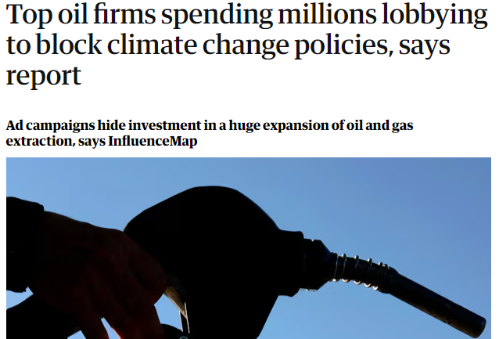


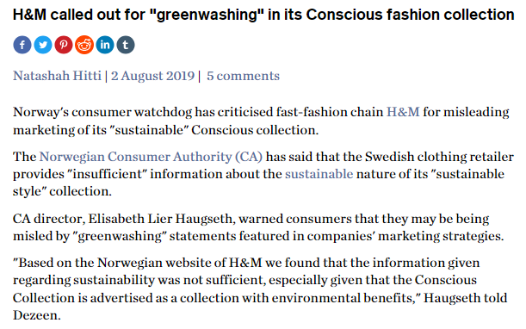

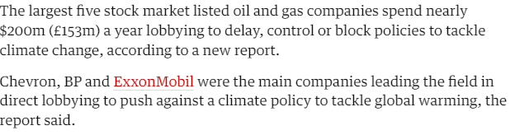
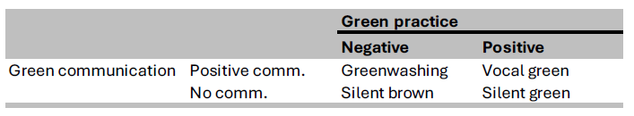
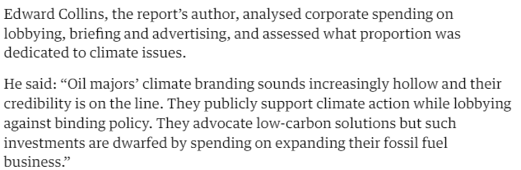

Greenwashing
Mismatch between environmental-related words and deeds
Misleading marketing
Decoupling
Fake news
Selective disclosure
…. 20 definitions in literature!
By Li et al. (2022) and Contreras-Pacheco and Claasen (2017).
Notes:
So, what is greenwashing?
Examples.
Fashion industry (more relatable)
H&M: https://www.dezeen.com/2019/08/02/hm-norway-greenwashing-conscious-fashion-collection-news/
Lobbying -> InfluenceMap 2019
Brief explanation of what lobbying is: lawfully attempting to influence the actions, policies, or decisions of government officials, Lobbying, which usually involves direct, face-to-face contact with legislators and policymakers
Lobbying will be the focus of this thesis
In literature there are multiple definitions
In general, it is a mismatch between actions and goals
Say that in this thesis I will focus on communication and lobbying

Slide 6



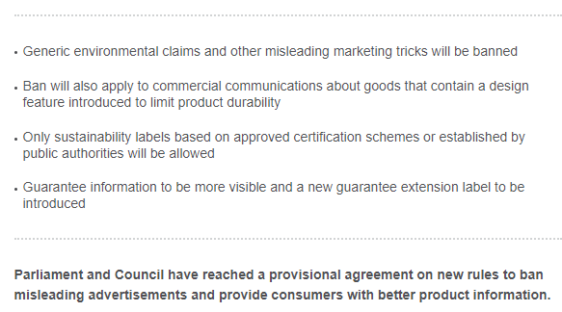
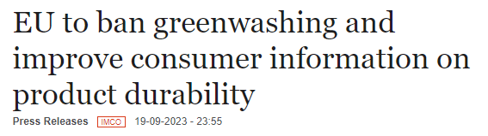
Greenwashing needs to be addressed
Consumers can be willing to pay more for sustainability
More than 1/3 of global consumers
70% of Gen Z
Micro- and macro- financial risks
Notes:
Why is it dangerous for the fight against climate change
Counterproductive for the fight against climate change: people (consumers and citizens) are misled by companies about what they buy
A lot of consumers are now buying sustainably
Micro- and macro-financial risks
““undermine the effectiveness of prudential policies as market participants would be able to circumvent regulations by hiding, for instance, their climate footprint. Furthermore, supervisors might not be able to identify early on the likely transition pathway the economy has entered, which can have important implications for financial stability”
Therefore, it needs to be addressed
For example, the EU is doing that

Slide 7
Greenwashing needs to be identified first
To what extent can a semi-automated approach effectively and holistically study companies’ communication and lobbying efforts to find potential evidence of corporate greenwashing?
Subquestions:
What operationalizable criteria can be used to determine the success of the approach?
What semi-automated approach can be created to potentially allow for a holistic study of companies’ communication and lobbying efforts?
To what extent is the created approach successful to the previously defined criteria when evaluated on a selected case?
Steps from design research approach
Notes:
To address greenwashing, we need to first identify it
Greenwashing needs to be identified so we can understand where we at in the environmental transition
The faster we see it, the faster we can act
We are 6 years away from the 2030 goals!
And automation of the identification can help in identify greenwashing promptly
Therefore, in this thesis, I tried to create a method that aims at identify greenwashing
Methods are lacking in the literature because there are mainly executed by hand
Therefore, the research question is: ….
I will answer this via a research design approach: I determined some criteria of evaluation, I created the approach, I demonstrated the use of the approach and I evaluated the approach itself
Ideally, such an approach could be used by consumers to get informed and avoid being misled by companies

Slide 8
Tackles climate change
Support decision-making
Fill research gaps
Relevance of research
Social
Systemic view of a grand challenge
Cutting-edge analysis
Scientific
EPA
Notes:
To summarize the Relevance:
It has Social: because it tackles a grand challenge and it can help consumers
Scientific: Such method is lacking
EPA (my master): these + Systemic view and Cutting edge analysis makes the research of relevance for this master

Slide 9
My created solution
Description of the created approach

Slide 10
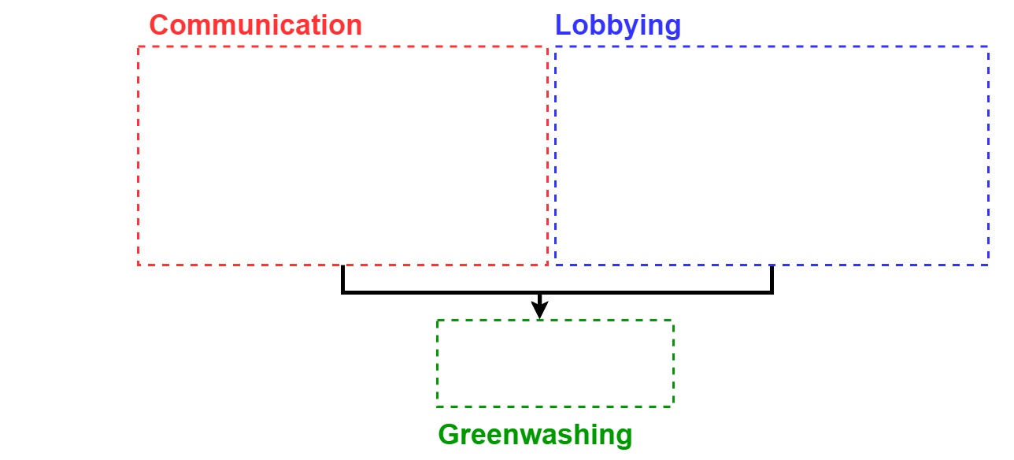
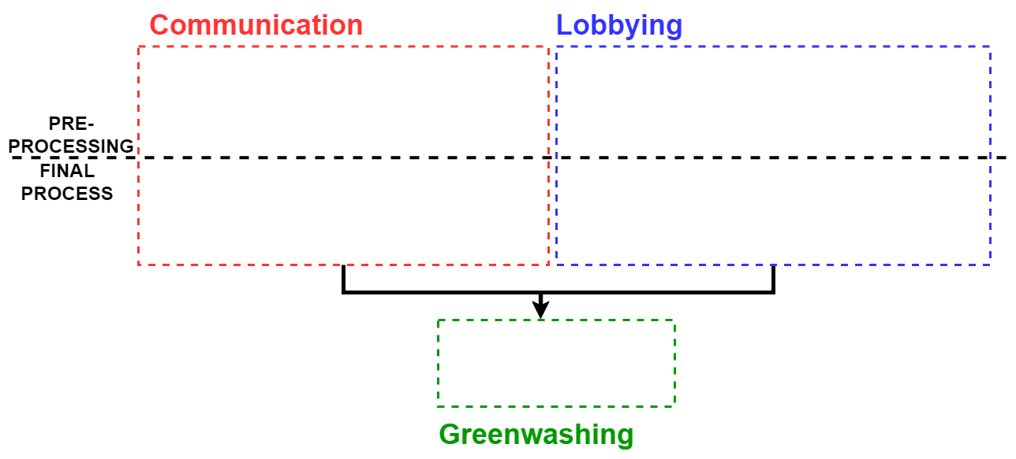
General overview
Notes:
What is important to keep in mind:
Greenwashing as a mismatch between words and deeds which in this case as intended as lobbying
I want the final method to be automated or semi-automated
General overview:
Three parts:
Communication, lobbying, final table
It is divided between a setting up phase and the actual approach

Slide 11
Communication
By Li et al. (2022) and Contreras-Pacheco and Claasen (2017).
Goal: Measure the distribution of a company’s climate relevant communication from generic to specific targets/actions the company is taking to understand how intense/positive their green communication is
How to do it?
By assigning to each sentence of a company a label (code) that represent different levels of communication intensity. This is done using GPT (ChatGPT) as a classifier (deductive coder)
These labels (codes) were first created (inductively coded) by me by analyzing sample companies
Notes:
The starting point is the definition that was already mentioned. Communication has a scale built within, from less to more positive communication regarding the environment
Goal: the scale has been understood as communication that is more general to specific targets and actions regarding climate change. Therefore, the goal is to measure how intense companies’ green communication are
How to do so:
By assigning to each sentence of a company a label (code) that represent different levels of communication intensity. This is done using GPT as a classifier (deductive coder)
These labels (codes) were first created by me by analyzing sample companies

Slide 12
Communication codes
Label | Description
stating_intentions | It is stating what they (will) do (policy) or want to achieve (target or goal).
acknowledge_importance | It is acknowledging the importance of them taking some actions.
support_for_policy | It is stating the support for a piece of climate legislation.
support_for_government | It is stating the support for governments’ climate action.
company_beliefs | It is stating a belief the company itself has about the topic in general.
common_beliefs | General beliefs about climate change or what is should be done about it but it is not clear who is expressing it.
“We remain committed to reaching net-zero carbon emissions across our operations by 2040." (Amazon)
Intensity
"The Volkswagen Group is committed to the goals of the Paris Agreement." (Volkswagen)
“Climate change is one of the most important global issues impacting business and society." (Aramco)
Notes:
These are the codes that were created inductively
They present different level of intensity/specificy
There is a scale in their specificity, in their commitments
The ones on top are more speciic about what a company wants to do to tackle climate change
The ones on the bottom are more general beliefs
These are some of the examples

Slide 13
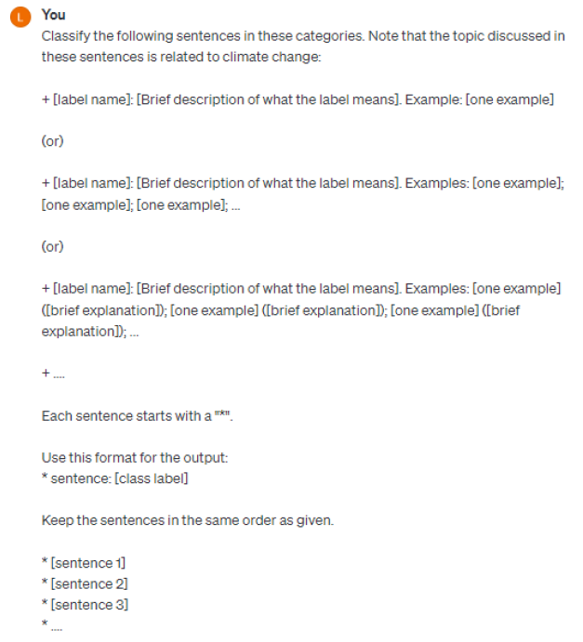
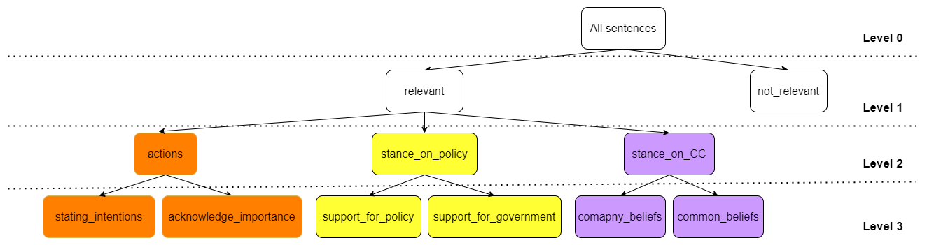
Communication codes
“We remain committed to reaching net-zero carbon emissions across our operations by 2040." (Amazon)
Accuracy:
GPT as a coder: 84%
GPT of this tree: 61%
X
X
X
X
X
X
Intensity
Notes:
To classify the sentences, I used GPT and the labels were put in a tree structure
GPT was chosen because of a lack of labeled data (from the inductive coding)
The tree structure was inspired from multi label classification tree from ML
The tree was determined by the meaning of the labels and by maximizing the accuracy of the classification by using prompt engineering
An example of how a sentence would get classified: through each level of the tree
Therefore, there is a prompt that ask for each level of the tree how to classify the sentence (see prompt in picture)
Note that this classification can be whole done automatically
Here I need to discuss accuracy:
GPT as a coder: the accuracy of each of these coding tasks (that is on each level given the label how to classify in the lower ones) is 84%
The overall accuracy of the coding tree is lower. Because to accurately code each sentence you need to go through the different levels (so each levels’ accuracy is multiplied). Therefore this can be already said as a limitation of my method
The accuracy was computed using the labeled data from the inductive coding

Slide 14
Lobbying
By Li et al. (2022) and Contreras-Pacheco and Claasen (2017).
Goal: Measure the lobbying activities on climate change
Data source: EU Transparency Register
How to do it?
By retrieving the total lobbying expenditures from TR
By determining how many meetings company with European Commissioner on climate change (proxy for intensity of lobbying on climate change). The list of all meetings is on the TR
Notes:
Looking at the table there is also a scale
So, goal becomes to quantify lobbying activities in the EU regarding climate change
The data comes from the Transparency register which is where companies it is mandatory to register their lobbying activities
Because of this data, we can’t know if companies are lobbying against regulations, therefore we can assume it only for polluting
How to do it?
The total expenditures (this is already on the TR)
The % of meetings that are related to climate change (the list of meetings is on the TR)

Slide 15

Meetings on climate change
Keywords:
General climate change-related: e.g. climate change, global warming, decarbonisation
Legislation: e.g., European Green Deal, EU Emission Trading System
Percentage: $\frac{3}{7}$ = 42.9%
Notes:
To get this number, I filter these meetings (example of data) based on a set of keywords that are previously determined by me:
Those that relate to climate change in general
Those that relate to legislation in particular
These are the results
And the percentage can be computed
Note that this analysis is done in a fully autoamted way

Slide 16
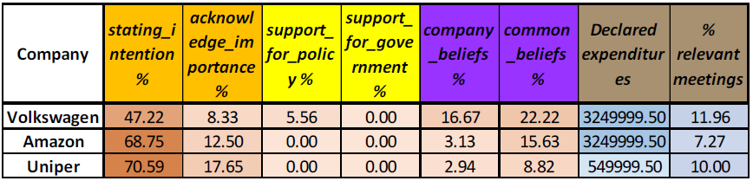
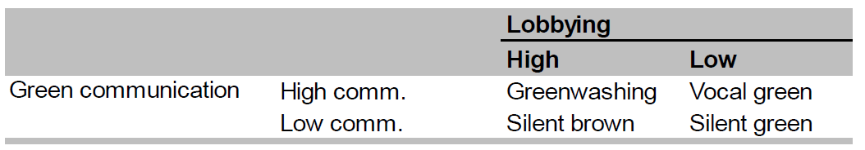
Greenwashing table
Lobbying: expenditures
and meetings on climate
Communication: distribution of sentences
Notes:
Here we combine the results of communication (distribution) and lobbying (the two computed variables), therefore, this can holistically study communication and lobbying. This could be automatically created
The results are presented in a way that can be open to interpretation
But at the same time we can use this table to interpret whether companies are greenwashing or not by using the definition of greenwashing discussed throughout the presentation. There is greenwashing if
High communication -> a lot of sentences in the “actions” branch because those are more specific
High negative green activities are translated to a lot of lobbying regarding climate change (that is a lot of money and a lot of relevant meetings)
Therefore there is a mismatch between words and deeds
Note that the table is color coded according to the scale of the variables

Slide 17
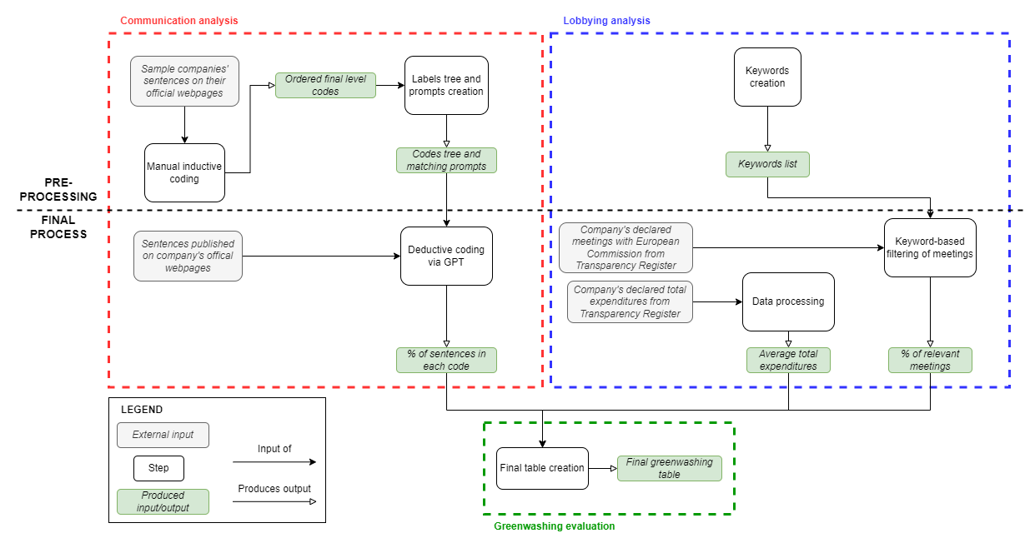
Created approach
Answer to SQ2

Slide 18
Results
Answer to research questions

Slide 19
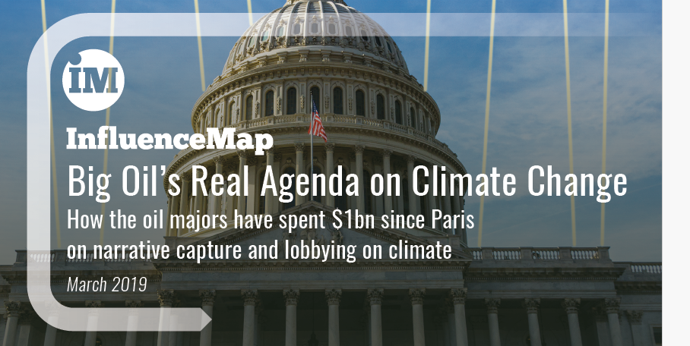
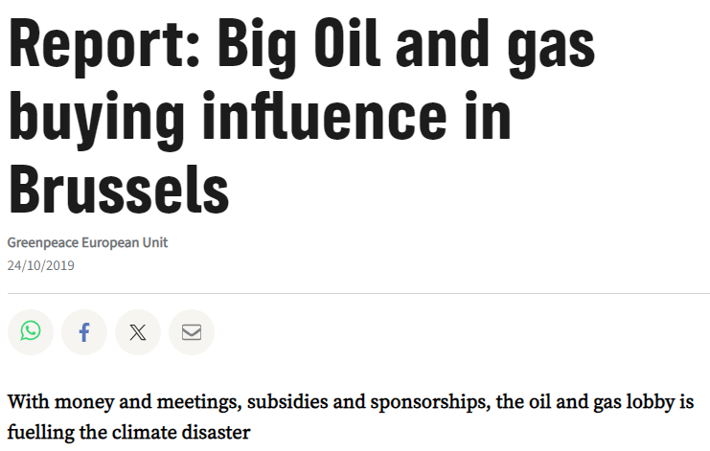

Demonstration and Evaluation
Demonstrated the approach on ExxonMobil and Shell data
The goal was to see with my approach I could come to similar conclusions as the sources
Running the analysis
Only for the communication I had to do one step by hand because of the low accuracy of the method (accuracy of coding now is 78%)
Therefore, the approach is at this state semi-automated
Notes:
I applied the method on new data, ExxonMobil and Shell
Goal: see if the method worked properly that is find similar conclusions as what these sources say
Data: from NGOs that describe these companies as greenwashing
I had to do some manual step (the first classification of sentences between “relevant” and “not relevant”) because of a low accuracy with this method
Therefore, the approach is indeed semi-automated

Slide 20
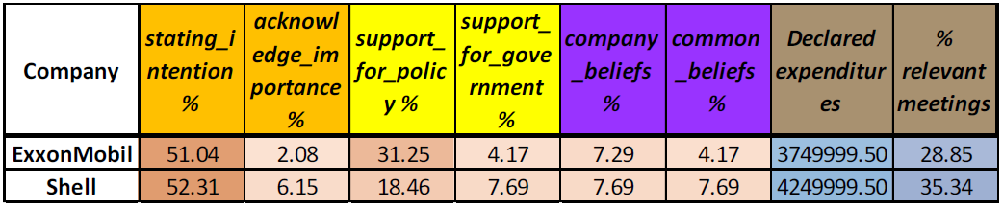
Demonstration of approach
Notes:
These are the results
Using the updated greenwashing definition I created
both companies present high levels of green communication since the majority of their sentences fall in the “stating_intention” code, the more specific code
WHILE and the lobbying expenditures and percentage of relevant meetings are significant (because we can assume their intentions because both companies are polluting since they operate in the oil and gas sector)
It is possible to call the data shown as evidence of potential greenwashing because there is a mismatch between words and deeds

Slide 21



Evaluation
Criteria | Communication | Lobbying | Greenwashing
Accuracy
Transparency
Reproducibility
Reusability
Answer to SQ1
Answer to SQ3
N/A
All data has been shared on GitHub: https://github.com/LudovicaBindi/collecting_greenwashing_evidence.git
Notes:
The criteria that were used are:
Accuracy: whether the approach was correct in identifying all the problematic communication and lobbying elements of the case that was picked so that the final results that the approach produces can be used to form a greenwashing accusation.
Transparency: is about sharing data, analysis, and choices so that they can be evaluated by others. The
Reproducibility: whether my analysis can be recreated in a different context. The discussion is based on the approach itself and the demonstration results.
Reusability: the easiness of use for other purposes of the data that was employed, produced, and then shared in this thesis.
Results of evaluation:
Accuracy: issue with the lobbying because the sources analyzed something else slightly
Transparency and reproducibility: issue with GPT because it is a proprietary and non-deterministic model, respectively

Slide 22
Conclusions
Answer to research question and reflections

Slide 23



Answer to research question
To what extent can a semi-automated approach effectively and holistically study companies’ communication and lobbying efforts to find potential evidence of corporate greenwashing?
semi-automated
runs the analysis holistically
used for a greenwashing appraisal
accuracy issues
transparency issue
reproducibility issue
approach has potential
automation for greenwashing identification has potential
Notes:
Answer to research question:
because it is indeed semi-automated, can holistically run the analysis (because the communication and lobbying gets combined together), and can be used for a greenwashing appraisal,
but the issues with accuracy and the other criteria I evaluated my approach against point out to the fact that this approach doesn’t fully run its analysis effectively, and, therefore, it is not the best model that could have been created since some of its validity issues are intrinsic to the method choices that were made.
I can say that my approach has potential
Automation has potential:
I saw it with my method
I saw that the idea of using codes + classifier can work and could be easily applied

Slide 24
Reflections
Limitations of research
Scientific contributions
The use of GPT creates issues of accuracy, transparency, and reproducibility
Filled the gaps in greenwashing literature
Issue of determining whether companies are lobbying against or for regulations
Advanced literature in the use of GPT as a deductive coder
Advanced literature in the studying of lobbying in the EU related to climate change
Notes:
Limitations of research and future resear:
Use of GPT:
Future research can spend more time in creating more labeled data so that ML or deep learning can be used
Issue intrinsic to TR:
Future research can look into indirect lobbying to understand how companies are lobbying
Scientific contributions
Filled the gaps in literature (I do have a method)
Advanced the use of GPT as a deductive coder
Studying of lobbying in the EU related to climate change

Slide 25



Policy recommendations
Clear rules for identifying greenwashing
Keep being vigil
Automation can help in detecting greenwashing
Notes:
To EU policy makers: Make sure that how you define greenwashing is clear
Because there are so many definitions of greenwashing
The identification will be less open to the interpretation of people
Automation can help!
To the citizens-consumers: be vigil
Greenwashing can slip through regulations since it is so multi-faceted
To conclude,
Automation can help in detecting greenwashing
Automation shouldn’t be pursued just for the sake of it (further biases can be introduced)
But because we are in need to be on track with climate change

Slide 26
Thank you!
Any questions?

Slide 27
Appendixes
Other material
Notes:
Chapter 3:
Brief description of the design research approach
Research diagram
List of objectives criteria
Summary of literature review for communication and lobbying
Chapter 4:
Communication:
Inductive:
Description of the final codes
From the original tree to the re-ordered one
Data of the sample companies
Deductive:
How I created the coding tree: maximing stuff (put all pictures here)
The full tree
Accuracies: full tree, pruned tree, tree of demonstration (manual first step)
Accuracy of each classification task
Example of how increasing the no. of examples increase accuracy
Screenshot of GPT that uses this
Lobbying:
Example of the data (screenshot)
List of keywords
Results:
Demonstration results (all the tables)
The table that summarizes the evaluation phase

Slide 28
Design research approach
Step | Description
problem identification and motivation | It aims at defining the problem to be solved and, therefore, justify the value that the solution to be created can have.
define the objectives for a solution | From the problem specification, the researcher should determine the objectives for the solution to meet
design and development | act of creating the artifact that can solve the identified problem: “conceptually, a design research artifact can be any designed object in which a research contribution is embedded in the design”
Demonstration | With the created artifact, the researcher should demonstrate the usability of the artifact in solving one or more examples of the original problem
Evaluation | By comparing the obtained results from the demonstration activity to the solution objectives previously determined, the research can measure how well the created solution solves the original problem
communication” | the researcher shares the problem and its importance, the created artifact, why it is useful, novel, rigorously designed and its effectiveness in solving the problem to researchers and other interested audiences
Peffers et al. (2007). A Design Science research Methodology for Information Systems research. Journal of Management Information Systems. https://doi.org/10.2753/mis0742-1222240302

Slide 29
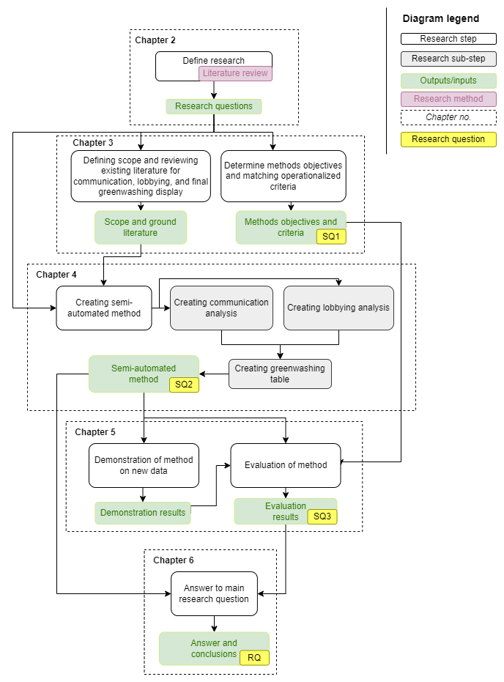
Research approach

Slide 30
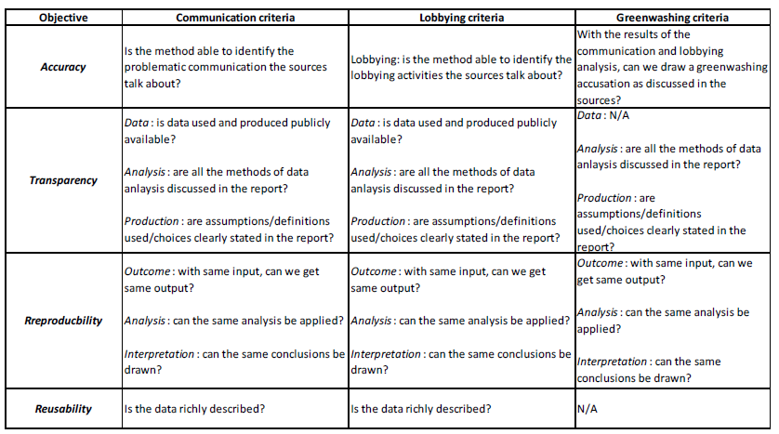
Objectives and operationalized criteria

Slide 31
Communication: existing methods
Discourse analysis:
Qualitative frame analysis
Quantitative frame analysis
Narrative Policy Framework
Content analysis:
Coding Qualitative Data
Topic modeling
Opinion mining
Relationship extraction

Slide 32
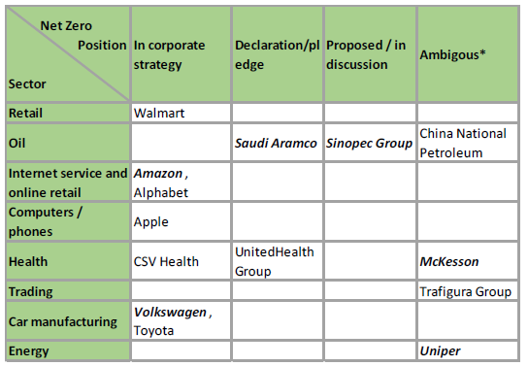
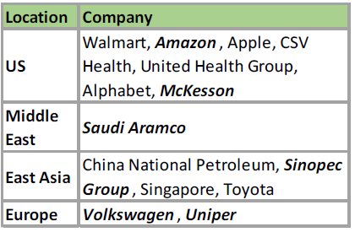
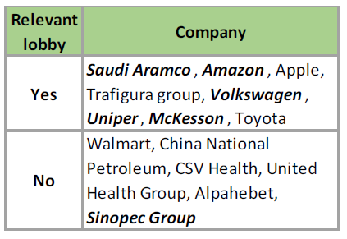
Communication: sample companies

Slide 33
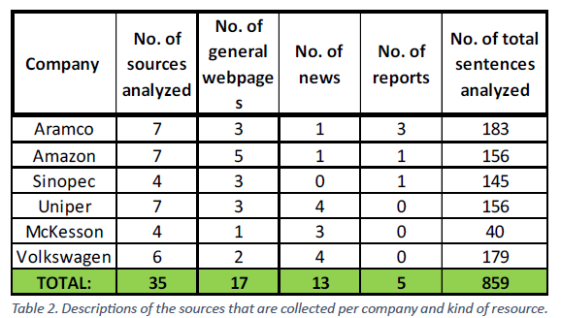
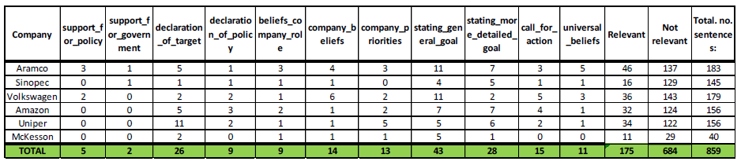
Communication: sample companies’ data

Slide 34
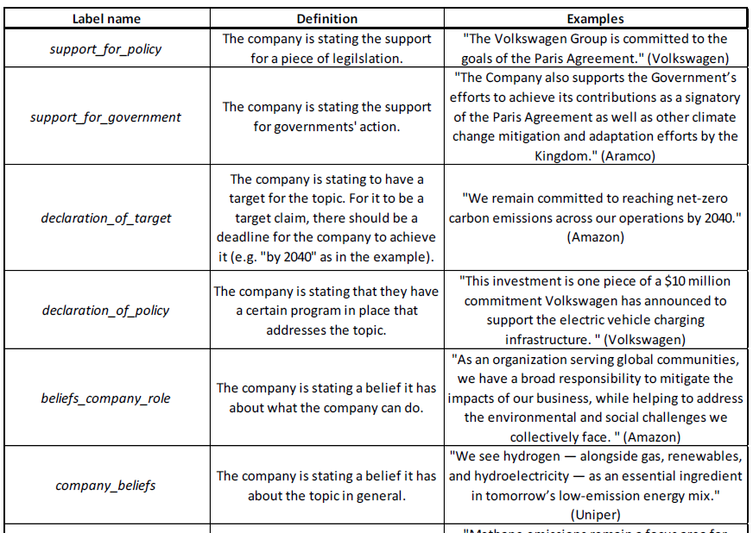
Communication: initial codes

Slide 35
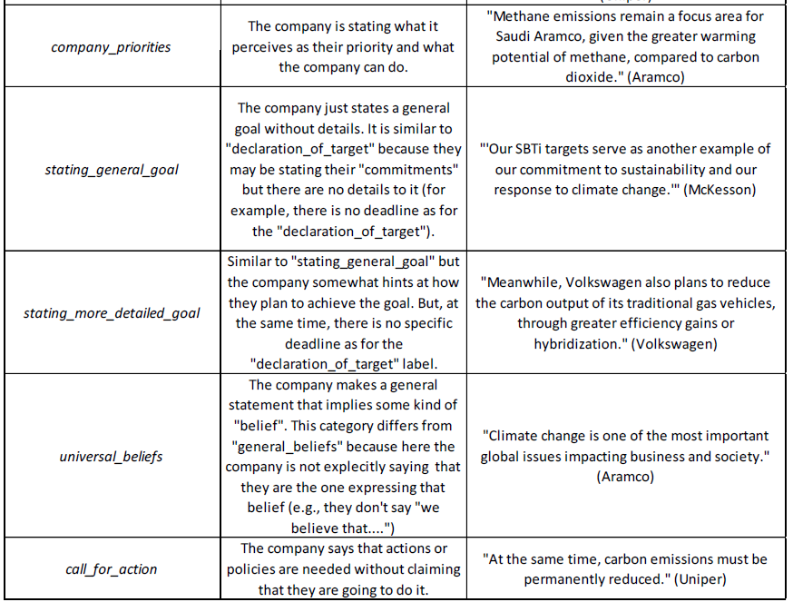
Communication: initial codes (cont’d)

Slide 36
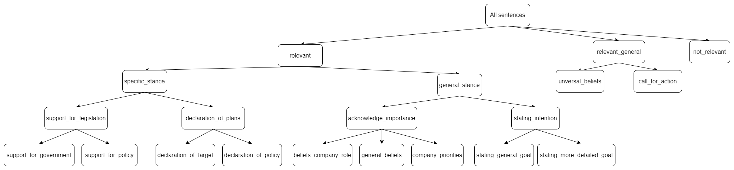
Communication: Creating coding tree - Original tree

Slide 37
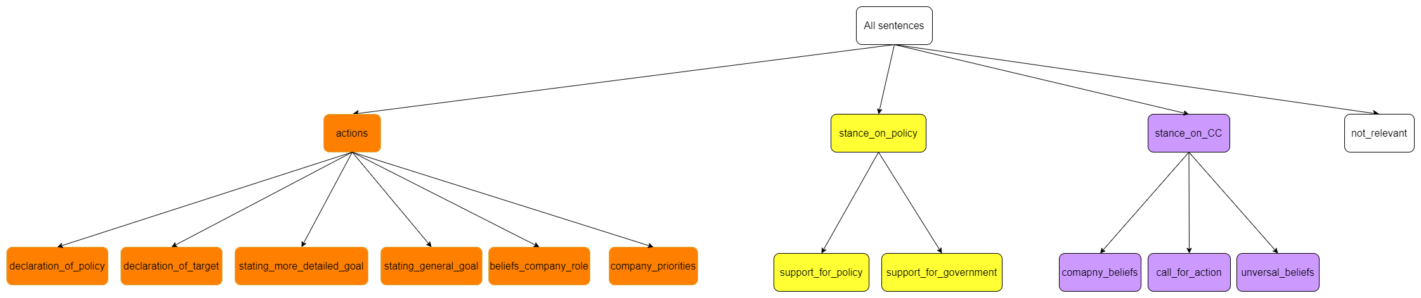
Communication: Creating coding tree – Re-ordered tree

Slide 38
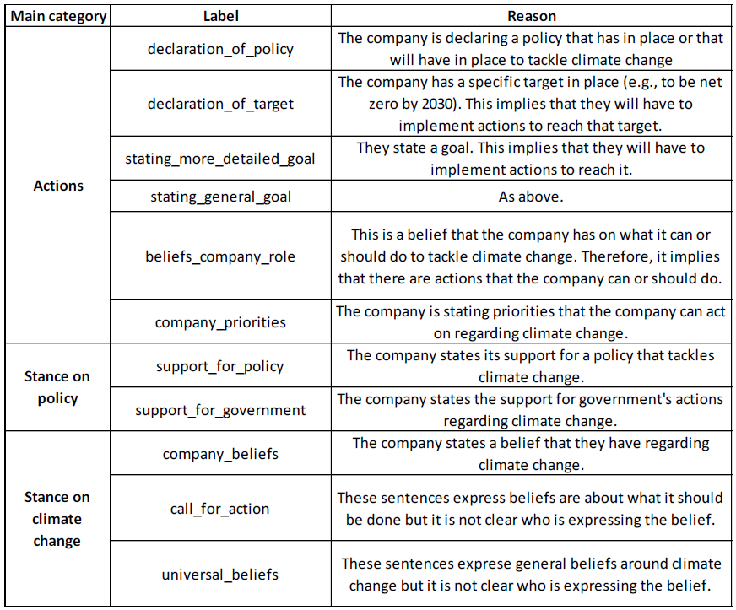
Communication: Creating coding tree – Re-ordered tree

Slide 39
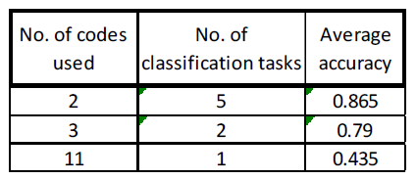
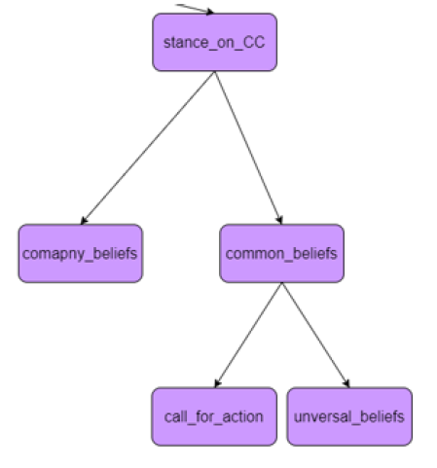
Communication: Creating coding tree – Maximizing for accuracy
Re-structuring tree: less child tree (left) + adding intermediate labels (below)

Slide 40
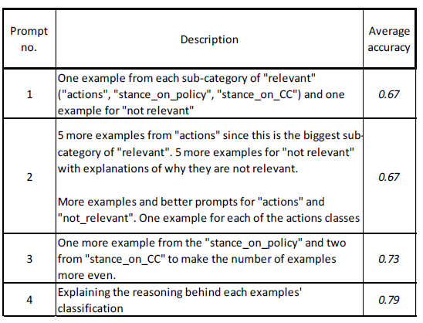
Communication: Creating coding tree – Maximizing for accuracy (cont’d)
Prompt engineering: few shot-learning + chain-of-thought inspired descriptions

Slide 41
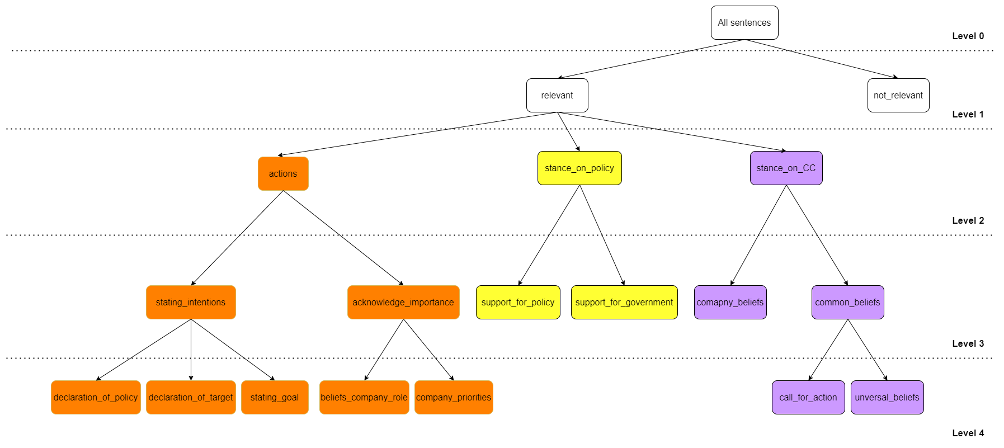
Communication: Creating coding tree – Full coding tree

Slide 42
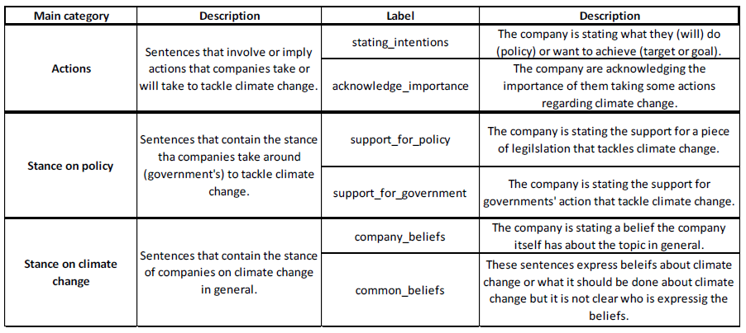
Communication: Creating coding tree – Pruned tree details

Slide 43
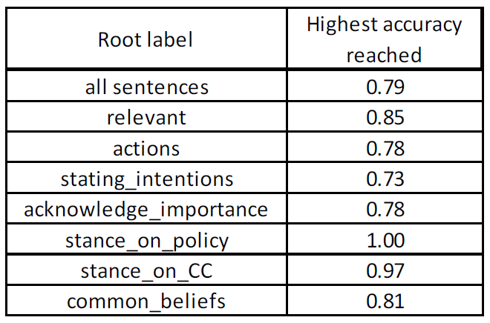
Communication: Creating coding tree – Accuracy coding tasks

Slide 44
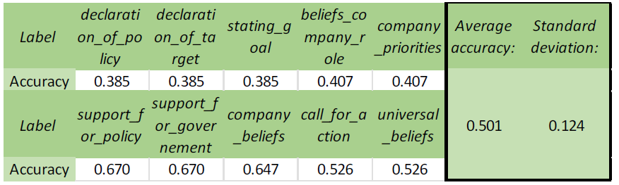
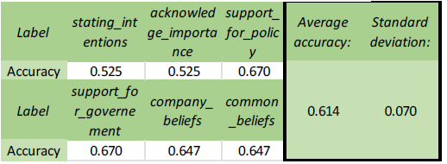
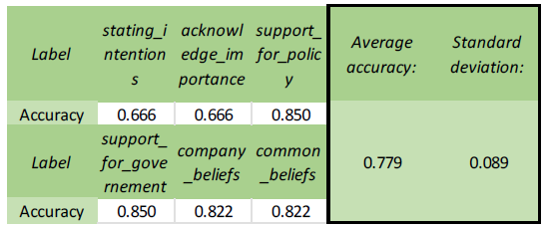
Communication: Creating coding tree – Trees accuracy
Full coding tree:
Pruned tree:
Pruned tree + first coding done by hand:

Slide 45
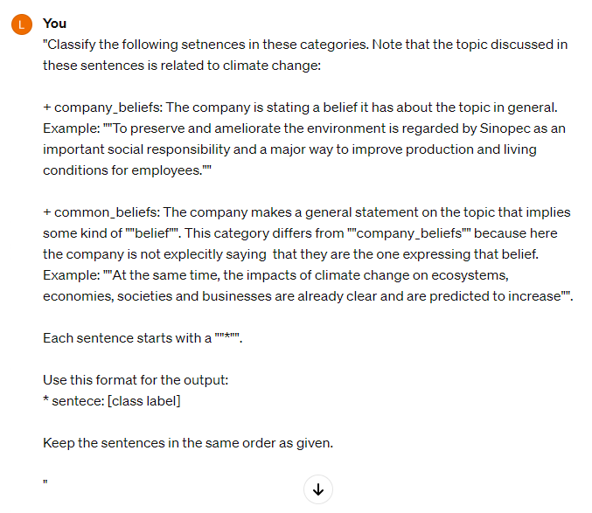
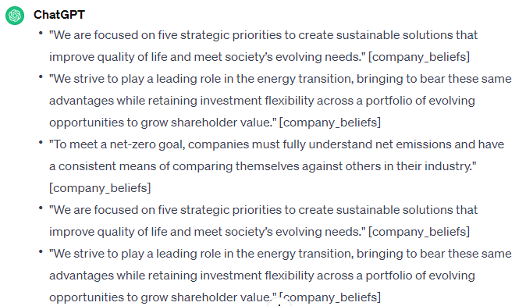
Communication: Creating coding tree – Examples of ChatGPT interaction

Slide 46
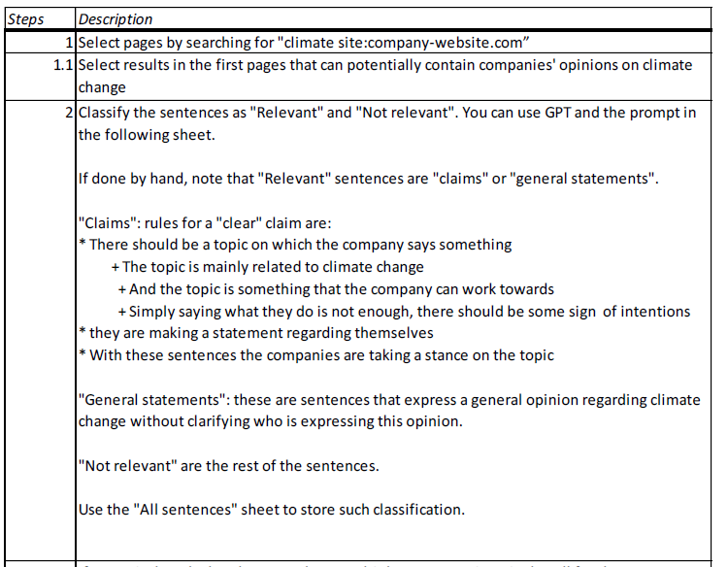
Communication: Summary of running deductive coding

Slide 47
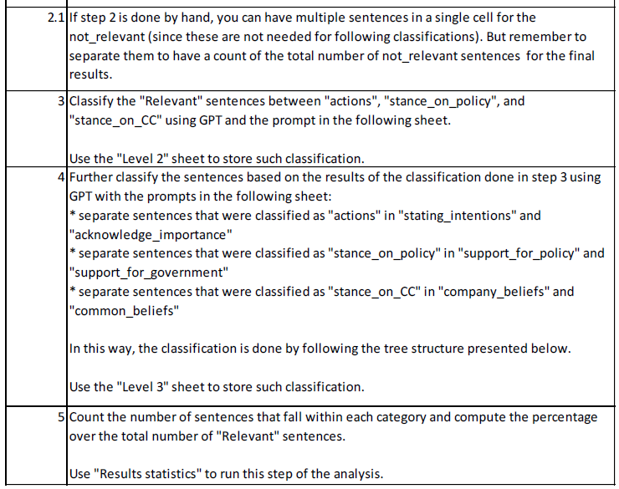
Communication: Summary of running deductive coding (cont’d)

Slide 48
Lobbying: existing methods
Papers on US lobbying show that lobbying related to climate change can be studied quantitatively in a simple way
The papers that studied lobbying in the EU around climate regulations don’t have the goal of quantifying the lobbying activities because they use more qualitative analysis
The Transparency Register could be used for this purpose since it contains a variety of data that has been already used quantitatively for studies on lobbying in general or in other sectors.

Slide 49
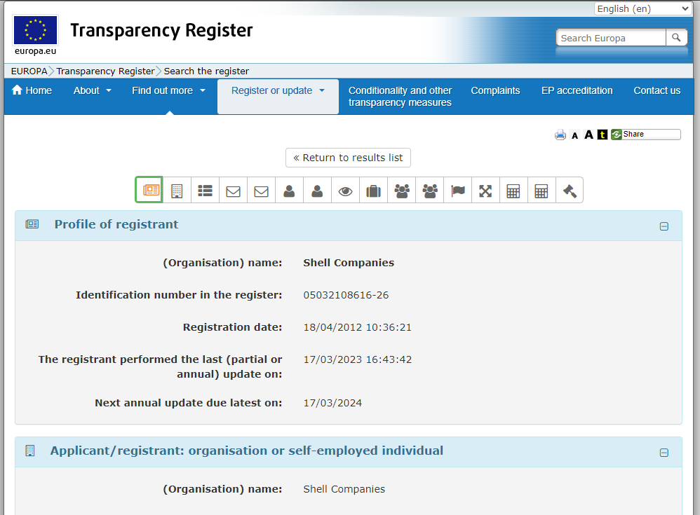
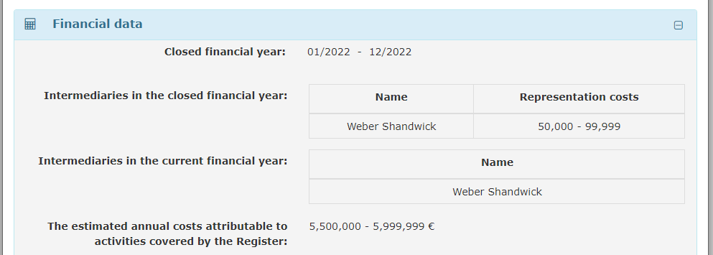
Lobbying: creating method – Example of data from TR
Homepage: https://ec.europa.eu/transparencyregister/public/homePage.do?redir=false&locale=en
Shell: https://ec.europa.eu/transparencyregister/public/consultation/displaylobbyist.do?id=05032108616-26

Slide 50


Lobbying: creating method – Example of data from TR (cont’d)
LobbyFacts homepage: https://www.lobbyfacts.eu/#representative-search
Shell on LobbyFacts: https://www.lobbyfacts.eu/datacard/shell-companies?rid=05032108616-26#data-card-data-meetings

Slide 51

Lobbying: creating method – Filtering keywords

Slide 52



Demonstration - Communication
Done by hand:
Done via GPT:

Slide 53

Demonstration - Lobbying

Slide 54

Evaluation – Summary

Slide 55
Evaluation – Summary (cont’d)

Slide 57
Title: example of slide
1

Slide 58
REMEMBER
The presentation is for a more general audience and is not expected to be exhaustive. Instead, you might want to emphasize the broader relevance/motivation of your research, explain why it is novel and challenging, share your key findings, and show that you understand the academic and practical implications of the work (so more introduction, results, discussion and less literature review and methods). If you wish, you can add more information in the appendix and use it in case you are asked questions for which you want to revert to the literature or the specificities of the methods/techniques.
Notes:
Le notes in BOLD sono quelle di cui ho qualche immagine

Slide 59
Introduction:
What is greenwashing
Why it needs to be addressed
Why an automatic method may be important
Research questions
Novelty
Approach:
The three parts
Communication: first I created the codes in an inductive manner, then the idea is to use GPT to deductively code them
Results: the answer to the research question (so it does the job but there is still work to do)
Conclusions:
Scientific contributions
Policy implication
Appendix:
Research design approach
How I created the approach for communication (examples of the deductive coding is done)
Lobbying keywords
General list of methods for communication

